Slide 1




Assess
Gather and analyse data from cloud providers
Strategies
Cloud Migration strategy and planning
01
02
Cloud Migration
03
03
Optimize
Monitoring & optimization of infrastructure
Migration
Cloud deployment and workload migration

Slide 2




01
03
Lift and Shift
Move applications as-is to the cloud infrastructure.
Rehosting
Transfer data and apps with minimal modifications.
Refactoring
Optimize apps for cloud-native architecture and benefits.
Replat forming
Slightly modify apps to leverage cloud capabilities efficiently.
02
04

Slide 3
Productivity Anywhere
Early Upgraded
Off site data storage
Cloud Migration Benefits
Lower Cost Ownership
No IT Maintenance cost
Always Up
Disaster Assistance

Slide 4


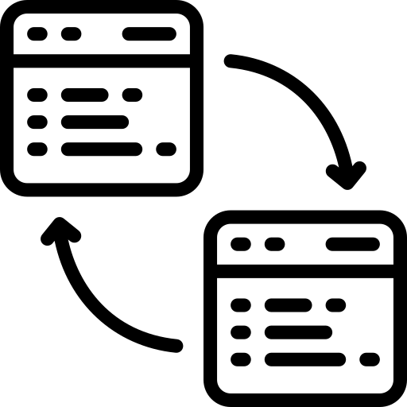

Lift and Shift
Rehosting
Refactoring
Replat forming
Move applications as-is to the cloud infrastructure.
Transfer data and apps with minimal modifications.
Optimize apps for cloud-native architecture and benefits.
Slightly modify apps to leverage cloud capabilities efficiently.

Slide 5




Design & Implementation
Operations
Assessment
Proof of Concept
Infrastructure Footprint
Application and Interdependencies
Data Protection Requirements
Disaster Recovery Requirements
Risk Identification
Pilot Migration Test
Test New Technology
Monitoring and Certification
Identify Opportunities for Improvement
Cloud Design & Build
Commissioning
Migration/Cutover Plan
Deploy Solution
Testing and Recertification
Monitoring and Management
Backup & Restore Check Up
DR Check up/Drill
Utilization and Performance
Re-engineering

Slide 6
Lift and Shift
Move applications as-is to the cloud infrastructure.
Rehosting
Transfer data and apps with minimal modifications.
Refactoring
Optimize apps for cloud-native architecture and benefits.
Replat forming
Slightly modify apps to leverage cloud capabilities efficiently.

Slide 7
Cloud Migration Test
Process Validation
Best Industry Practices
Common Challenges
Cloud Migration Test
Regular Testing
Software Testing Types

Slide 8
Lift and Shift
Move applications as-is to the cloud infrastructure.
Rehosting
Transfer data and apps with minimal modifications.
Refactoring
Optimize apps for cloud-native architecture and benefits.
Replat forming
Slightly modify apps to leverage cloud capabilities efficiently.

Slide 9
01
02
Lift and Shift
Move applications as-is to the cloud infrastructure.
Rehosting
Transfer data and apps with minimal modifications.
03
04
Refactoring
Optimize apps for cloud-native architecture and benefits.
Replat forming
Slightly modify apps to leverage cloud capabilities efficiently.

Slide 10
01
02
03
04
Lift and Shift
Move applications as-is to the cloud infrastructure.
Rehosting
Transfer data and apps with minimal modifications.
Refactoring
Optimize apps for cloud-native architecture and benefits.
Replat forming
Slightly modify apps to leverage cloud capabilities efficiently.

Slide 11
Icons

Slide 12
Icons

Slide 13
How To Edit Shapes
You can add and edit some shapes to your presentation to present your data in a visual way.
Choose your favourite infographic and insert it in your presentation using Ctrl C + Ctrl V or Cmd C + Cmd V in Mac.
Select one of the parts and ungroup it by right-clicking and choosing “Ungroup”.
Change the color by clicking on the paint bucket.
Then resize the element by clicking and dragging one of the square-shaped points of its bounding box (the cursor should look like a double-headed arrow). Remember to hold Shift while dragging to keep the proportions.
Group the elements again by selecting them, right-clicking and choosing “Group”.
Repeat the steps above with the other parts and when you’re done editing, copy the end result and paste it into your presentation.
Remember to choose the “Keep source formatting” option so that it keeps the design. For more info, please visit Slideegg (Tips & Tricks).

Slide 14
Terms Of Use (Free Users)
If you are a free subscriber, you should credit SlideEgg by keeping the “Thank You” slide.
Kindly refer to the following slide for the Terms of Use for premium users.
You can:
Customize or edit this template
Use this template for both business and personal endeavors.
You can not:
Sell, rent, or second-license SlideEgg content or its altered version. Promulgate, unless explicitly permitted, SlideEgg content, by SlideEgg.
Incorporate SlideEgg content in any database or file online or offline.
Obtain SlideEgg content’s copyright.
Kindly refer to our Tutorial page or FAQ for advanced slide modification guidelines.

Slide 15
Terms Of Use (Premium Users)
Being a premium subscriber, you have the privilege of using this PPT template
without giving attribution to SlideEgg or keeping the “Thank You” slide.
You can:
Customize or edit this template.
Use this template for both business and personal endeavors.
Circulate or share the editable format of this template with anyone you want.
You can not:
Sell, rent or second-license SlideEgg content or the altered version of it. Promulgate or include the templates in any other services database
that performs as distribution or resale platform, unless explicitly permitted, by SlideEgg.
Incorporate the elements used in SlideEgg templates separately.
Obtain SlideEgg copyright for the elements used in this template as a logo or trademark.
Kindly refer to our Tutorial page or FAQ for advanced slide modification guidelines.

Slide 16






Thank You!
We respect your valuable time with SlideEgg!
If you have any questions, please reach us
Do you have a design request, please visit our Deckez site.
CREDIT: SlideEgg created this PowerPoint template.
Let this slide be kept for attribution.
www.slideegg.com

